Slide 1






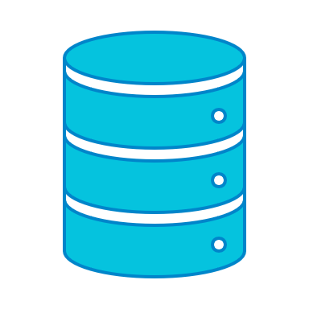


Development Ecosystem
GitHub
git
conda
conda
Python
Anaconda
packages,
libraries,
tools
Studio3T
PyCharm
Jupyter
Postman
MongoDB
Tableau

